Slide 1
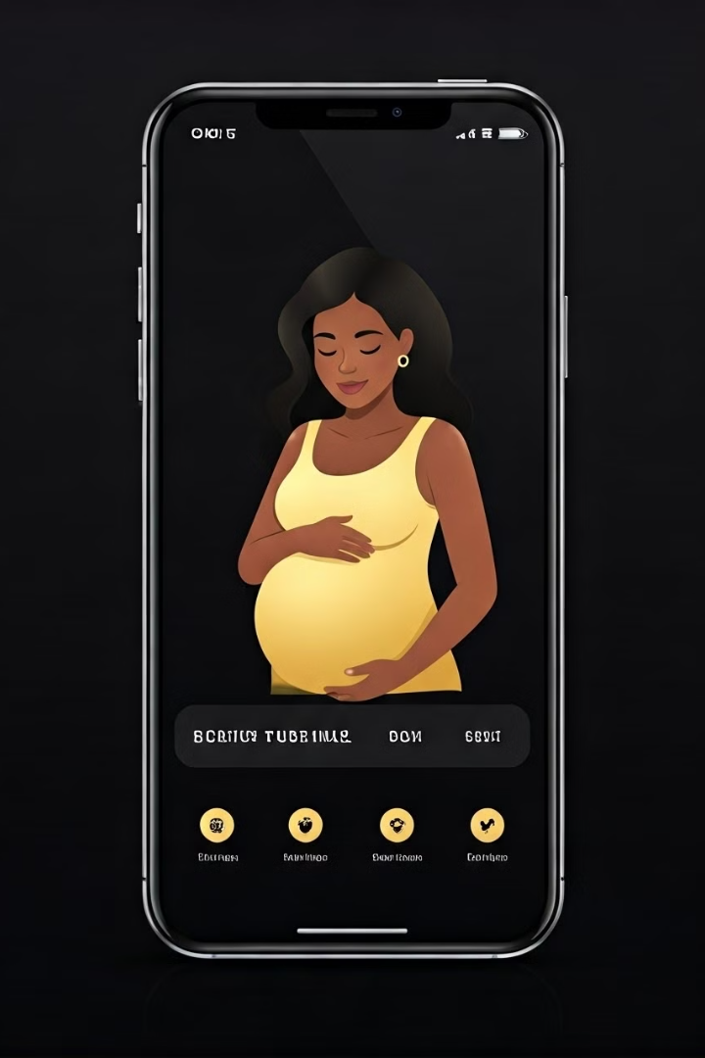
Antenatal Care Reminder Application
Managing Patient Reminders Efficiently
Presented by: Date: December 2, 2024
by Syllas Otutey

Slide 2

Introduction
Antenatal care is crucial for maternal and fetal health. This application simplifies appointment tracking, ensuring timely reminders.
1
Efficient Appointment Tracking
2
Centralized Data Management
Consolidates patient data, reducing manual workload and errors.
The app tracks appointments, due dates, and reminders.
3
Problem Analysis
Manual systems are prone to errors, lacking real-time updates.

Slide 3
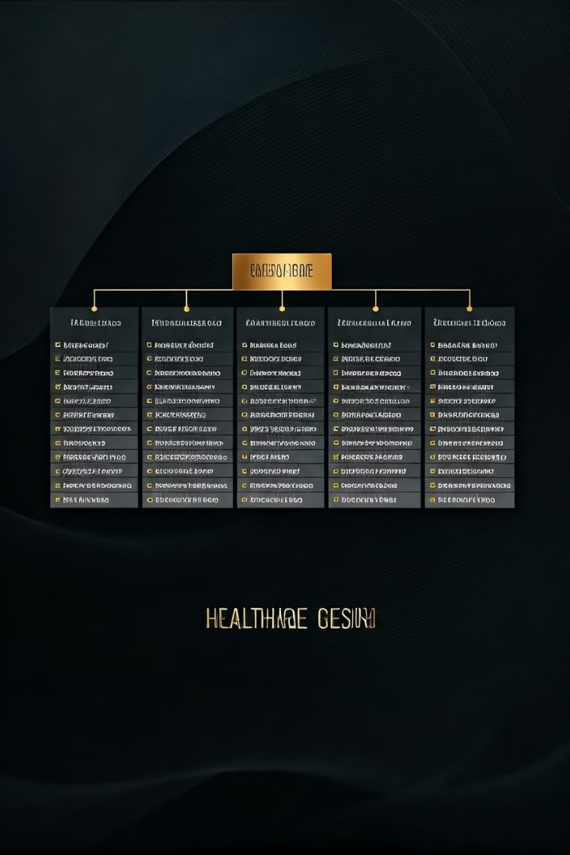
Key Features for the User Interface
Patient Name:: A text input field to enter the patient's name.
Due Date: A date input field to enter the patient's due date (format: MM-DD-YYYY).
Reminder Time: A datetime input field to specify when the reminder should occur
(format: MM-DD-YYYY HH:MM).
Save Button: A button to save the entered information to the database.
Feedback: Alerts that confirm success or show error messages when
input is incomplete or incorrect.

Slide 4
Features of the Application
Patient Data Storage
Appointment Reminders
Database Integration
Securely store names, due dates, and reminder times.
Alerts users about antenatal appointments.
Utilizes MySQL for reliable data management.
Efficient data entry
Timely notifications
Secure access
Automatic updates
Customizable alerts
Easy retrieval

Slide 5
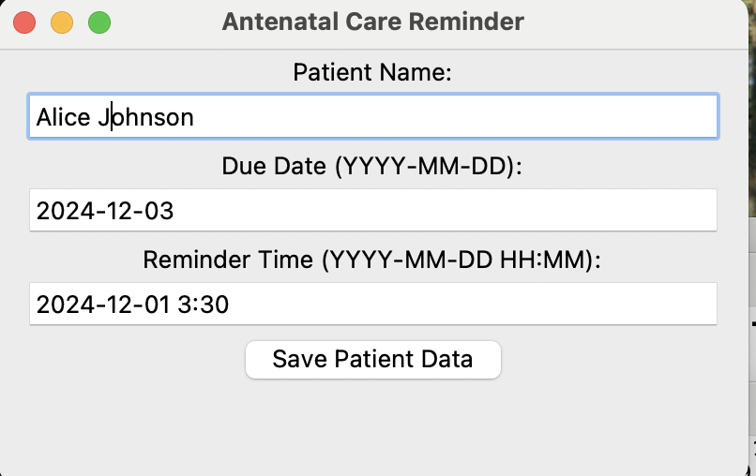
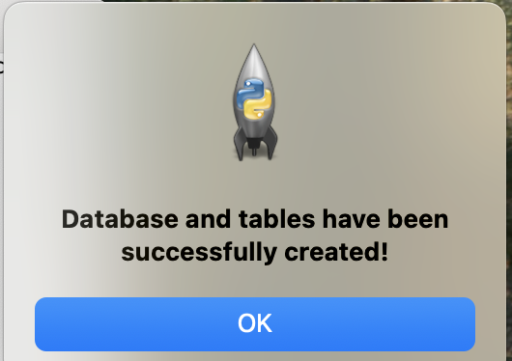
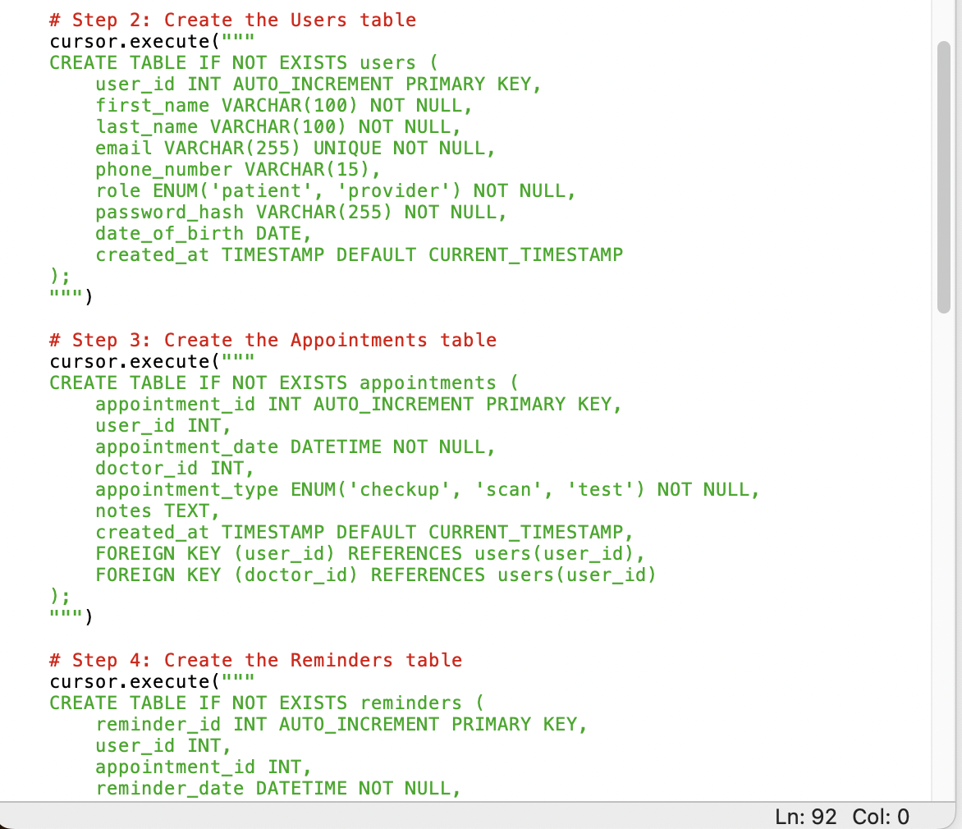
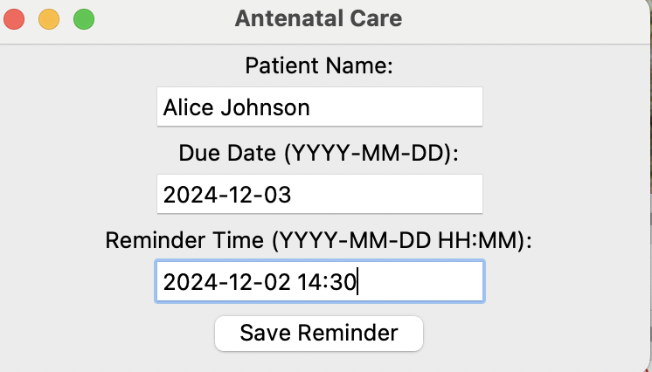
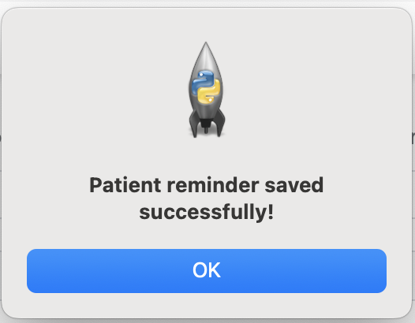
Imported modules
import mysql.connector
from tkinter import messagebox
from datetime import datetime,
import tkinter as tk

Slide 6
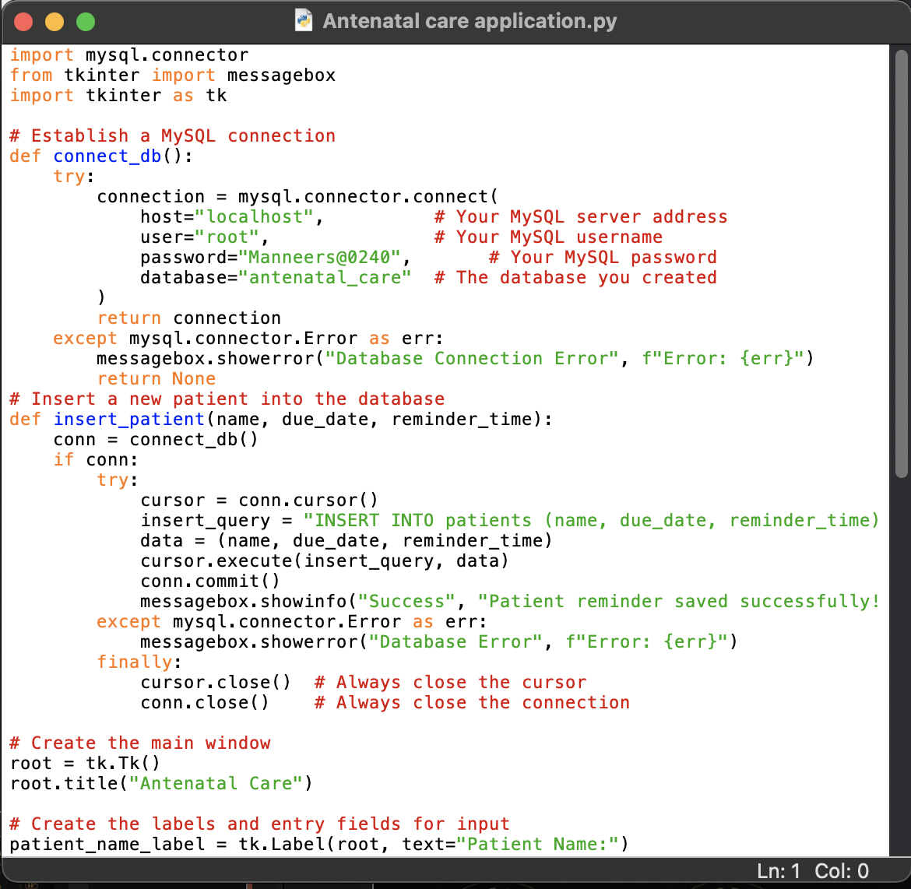
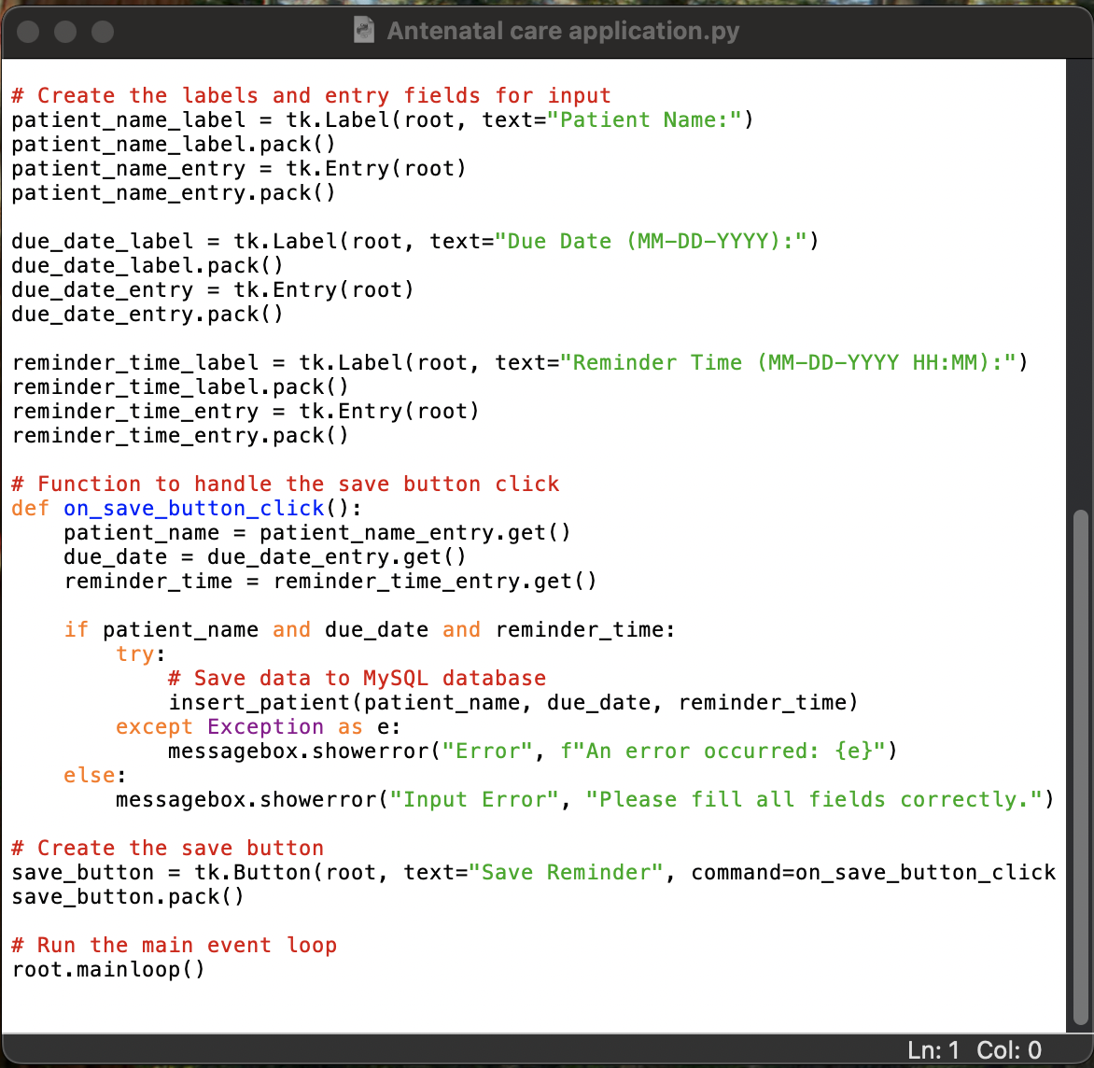

Slide 7

LONG TERM GOALS
1
Email and SMS Notifications
Automatically send reminders via preferred channels.
2
Advanced Search and Filter
Search patient records by various criteria effortlessly.
3
Comprehensive Reporting
Generate detailed reports on patient appointments and reminders.
4
Web and Mobile Expansion
Broaden access through web-based and mobile versions.

Slide 8




THANK YOU

